Slide 1
Jupyter Notebook

Slide 2
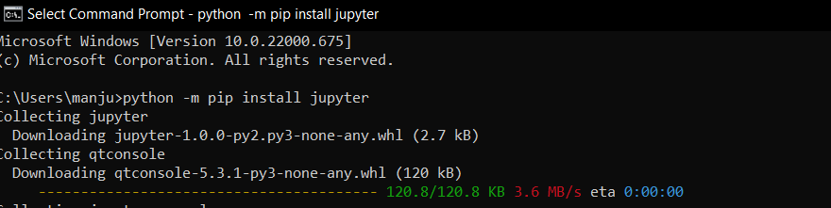
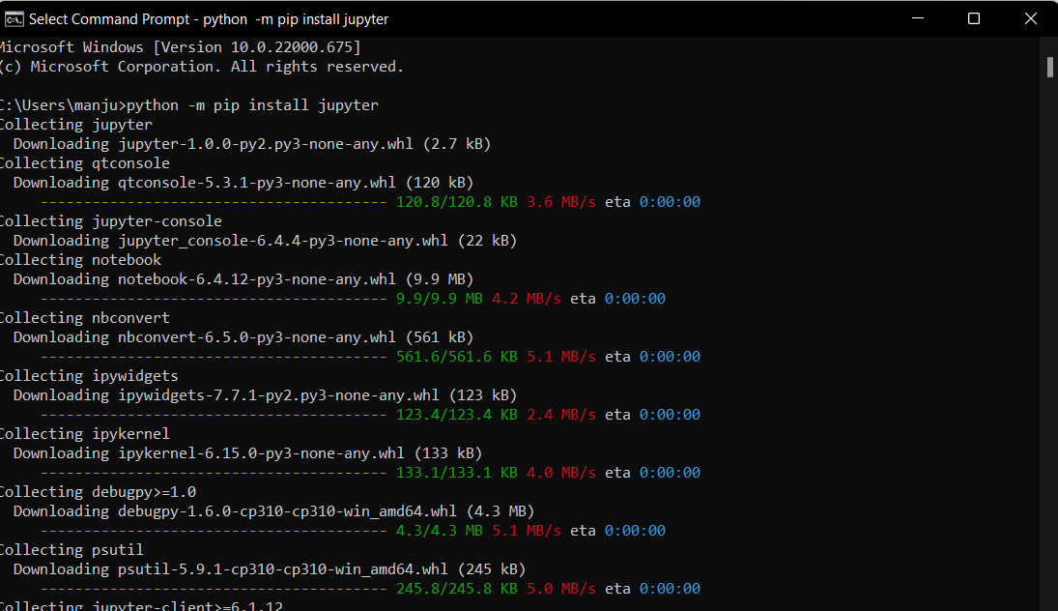
Open command prompt → type → python –m pip install jupyter

Slide 3
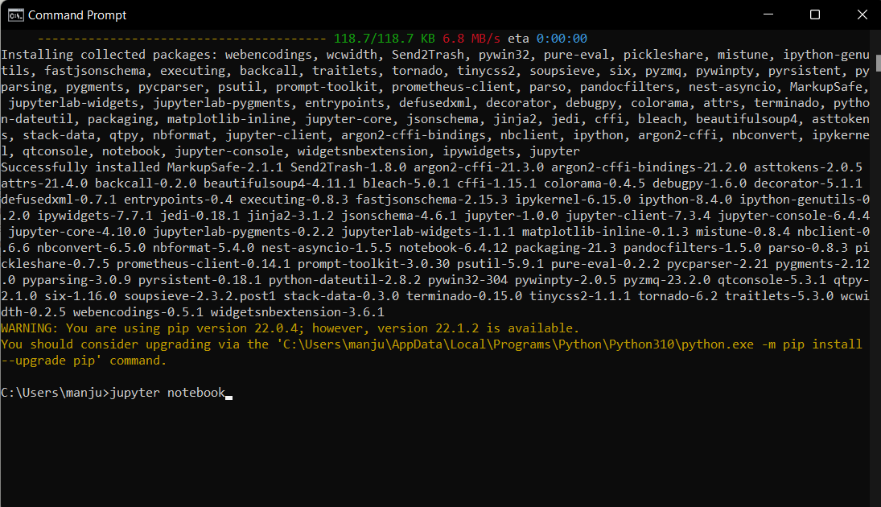
After the installing the jupyter , type → Jupyter notebook and click on Enter

Slide 4
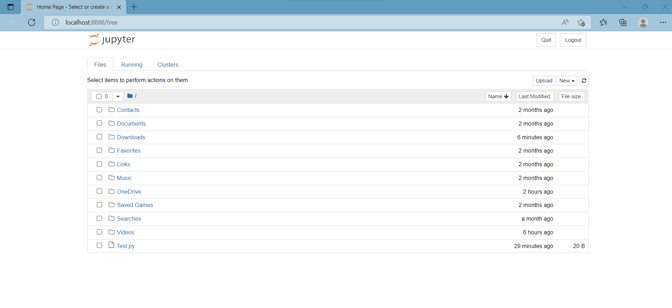
It will open default browser → jupyter notebook is web based open source.

Slide 5
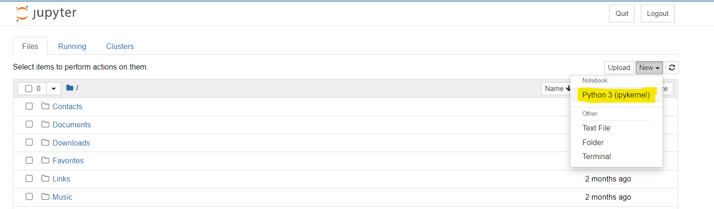
Click on New and select “Python 3”

Slide 6
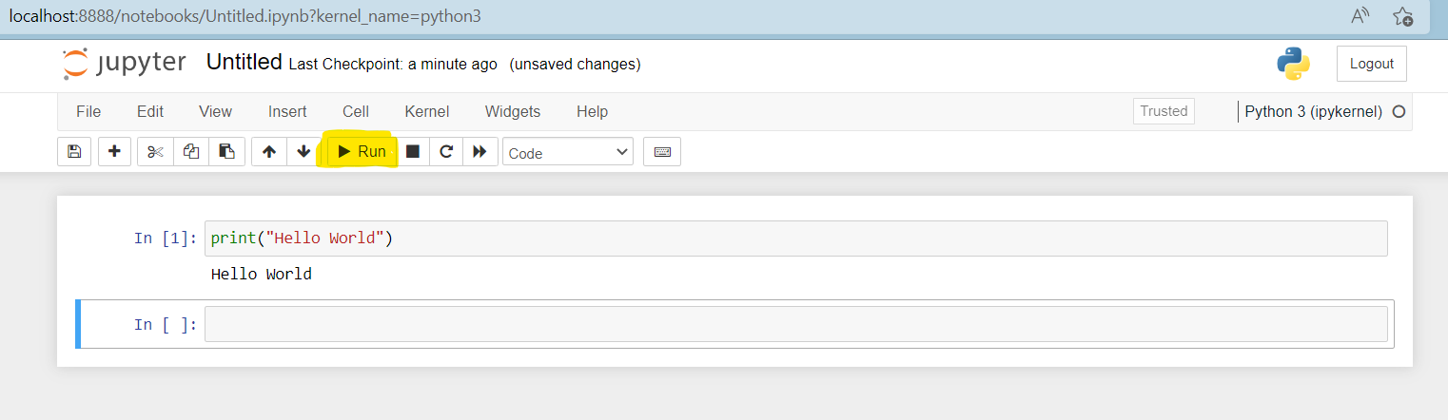
Type print(“Hello World”) and Click on RUN.

